Slide 1
Python
Installation

Slide 2
Downloads
https://www.python.org/downloads/
For
Windows, Linux/UNIX,
Mac OS X,
Other (Python for IBM, iOS )

Slide 3
Use v3.0
Download the latest version for Windows
3.6.5 – As on May 31,2018
Stable versions 3.5.1
python-3.6.5-amd64.exe
Always use 64 Bit, instead of 32 bit

Slide 4
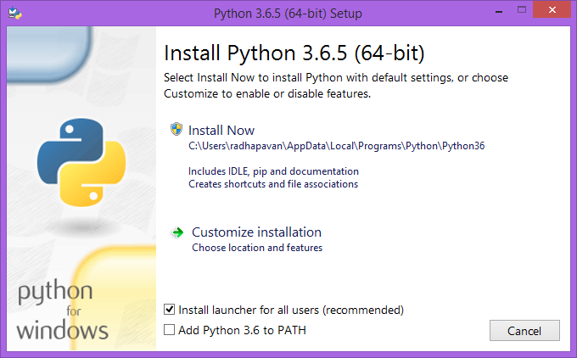

Slide 5

Customize installation

Slide 6
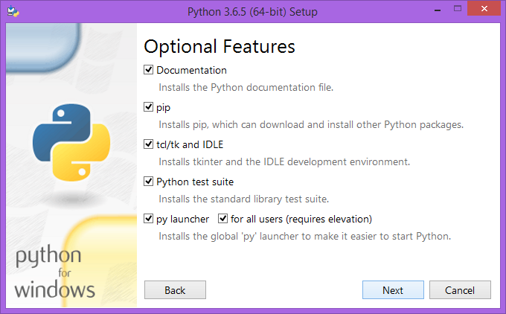

Slide 7
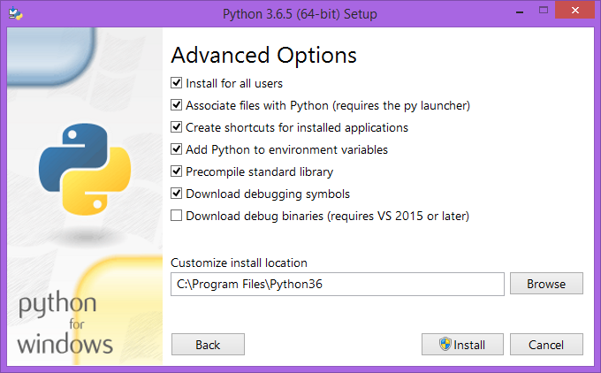
C:\Python36

Slide 8
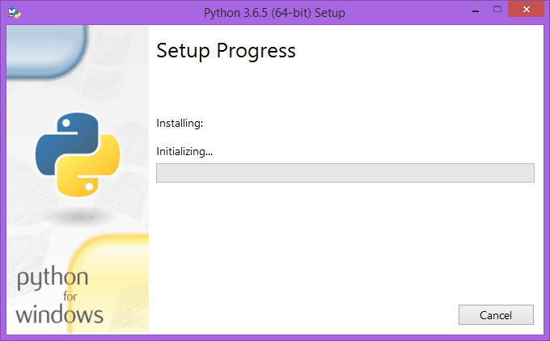

Slide 9
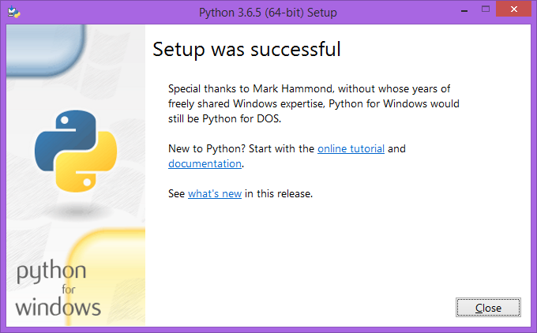

Slide 10
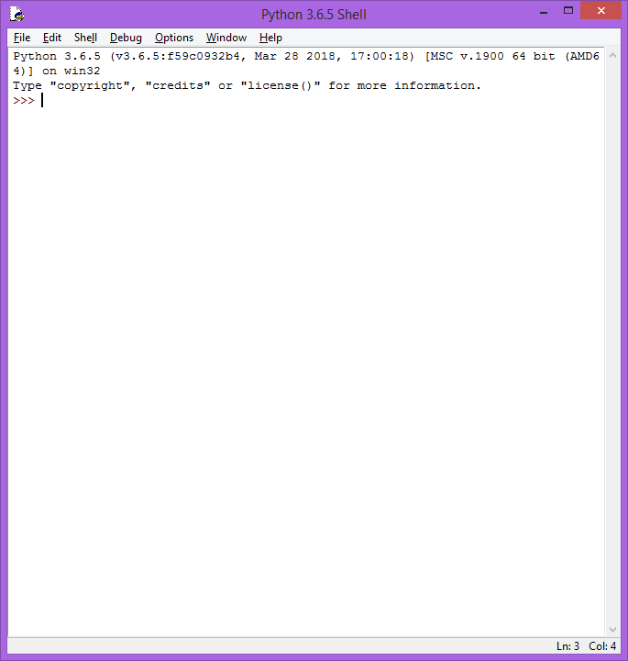
Test installation
Open – Python IDLE , Go to >>> Prompt

Slide 11
>>> print("Hello world")
Hello world
>>> print "hai"
SyntaxError: Missing parentheses in call to 'print'. Did you mean print("hai")?
>>>

Slide 12
Important
You can run python scripts
Each file save as “filename.py”
Extension as PY
We will use other than Default IDLE
Pycharm, Eclipse are best ones/ most used

Slide 13
3 Ways – You can run
From DOS prompt
From IDLE – Editor
From Shell
Ofcourse Best way, use separate Editor like Pycharm. We will cover this in details !!!

Slide 14
From IDLE(Editor)
Open IDLE
New - > edit
Enter piece of code. Save that in a Folder eg: c:\pywork
Save this file as test.py
Press – F5 ( Run)
You can see output in console

Slide 15
From shell - Console
exec(open(“file.py”).read()
>>> exec(open("C:\\pywork\\test.py").read())
My name pavan
12
>>>
Note : No good solution to clear several cmds ( need explanation to students)
Note: >>> python
Traceback (most recent call last):
File "<pyshell#6>", line 1, in <module>
python
NameError: name 'python' is not defined
>>>

Slide 16
Python to PATH
Open system properties
https://www.pythoncentral.io/add-python-to-path-python-is-not-recognized-as-an-internal-or-external-command/
Click on “Environment Variables”
Set Path for Python

Slide 17
NameError: name 'python' is not defined
It looks like you are trying to start the Python interpreter by running the command python.
However the interpreter is already started. It is interpreting python as a name of a variable, and that name is not defined.

Slide 18
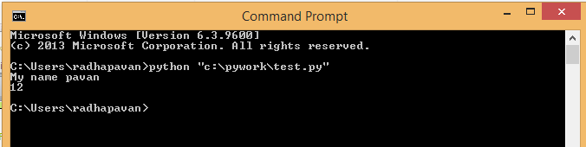
From DOS
python “file/path/file.py”
Windows “\” , in Linux “/”

